Slide 1
Aqua framework
- An Overview

Slide 2
About MVC Pattern
In a complex applications that present a large amount of data to the user, a developer often wishes to separate data (model) and user interface (view), so any changes to the user interface will not affect data handling, and the data can be reorganized without changing the user interface.
The model-view-controller solves the problem by decoupling data access and business logic from data presentation and user interaction, by introducing an intermediate component: the controller.
An application can be split into separate layers: presentation (UI), domain logic, and data access.

Slide 3
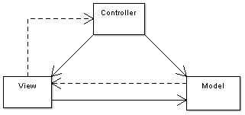
About MVC Pattern (Contd…)
In MVC the presentation layer is further separated into view and controller.
Model
Domain-specific representation of the information that the application operates. Domain logic adds meaning to raw data.
Many applications use a persistent storage mechanism to store data. MVC does not specifically mention the data access layer because it is understood to be underneath or encapsulated by the Model.

Slide 4
About MVC Pattern (Contd…)
View
Renders the model into a form suitable for interaction, typically a user interface element. Multiple views can exist for a single model for different purposes.
Controller
Processes and responds to events, typically user actions, and may invoke changes on the model.

Slide 5
About Microsoft UIPAB
Framework for developing user interface processes.
Separate the control flow (navigation) from the pages, forms, and controls that the user interacts with.
Abstract state management for a use case from the forms and controls working on that data.
Enable the use of the same programming model for different types of application.
Write applications that manage users' tasks in complex scenarios.

Slide 6
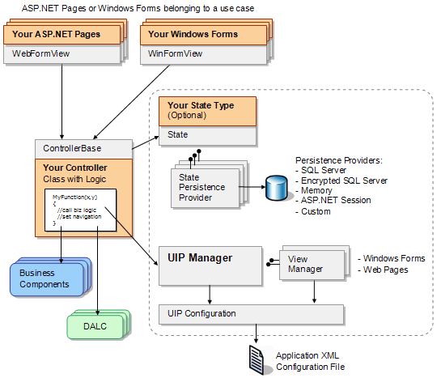
Microsoft UIPAB

Slide 7
Features of Aqua Framework
Presentation Flexibility (Skins or Themes)
Maximum reusability
Reduced Time to Market
Ease of Deployment
Easy Back Out
Ability to customize/personalize
Stronger Security
Increased Developer Productivity

Slide 8
Framework – Block Diagram

Slide 9
Common Controller
Retrieve the data from the state and perform validation on the User Input.
Communicate with the business services.
Based on the response from the Business Service and Input Validation, the controller propagates the desired result to the same view or different view and updates the state information.
Controls view navigation.

Slide 10
Control Library
The Control Library is a pool of all the controls.
Provides a wrapper around the standard dot net controls.
All the controls implements a common interface with methods SetData() and GetData().
The User Interface Designer will design the screens of application by dragging and Dropping controls on the screen and setting the properties of the control in an IDE tool.
All the Controls will be in a namespace Liberty.Framework.ControlLibrary.ControlName.

Slide 11
System services
Common Services used
Configuration
Caching
Logging
Exception Handling
Authorization

Slide 12
Service Manager
The Service Manager is a generic service which manages all the Business and System components and Services from a local or remote location.
The Type of service to be retrieved is configurable.
It is essentially a layer of Abstraction between the Application and the Business Services.

Slide 13
Business Service
Controller requests the Business Service to get a particular Service by passing the required Input Data.
BS includes asynchronous/synchronous method.
Framework Business Service
Custom Business Service
Streaming Service

Slide 14
Transformers
Transformers used to translation the request and response data to the remote services
Remote service can be web services or any other form .

Slide 15
Adapters
Adapters for each kind of remote services needed
Soap adapter – Web services
TAP adapter - Tap messages
ICE adapter - ICE interface

Slide 16
Other Components
Download Manager
BootStrapper
Validation Manager

